Slide 1
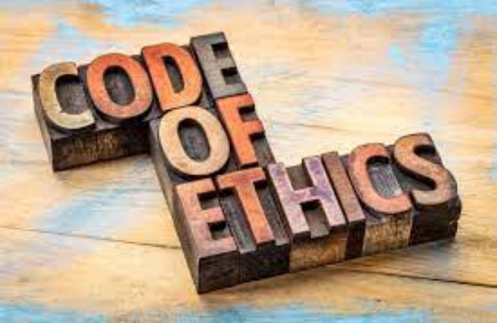
Unit 7.1 - Ethics and Ownership
Prepared by: Koh Kian Hua

Slide 2
Objectives
After completing this unit, students should be able to:
Show understanding of the need for and purpose of ethics as a computing professional.
Show understanding of the need to act ethically and the impact of acting ethically or unethically for a given situation.
Show understanding of the need for copyright legislation
Show understanding of the different types of software licencing and justify the use of a licence for a given situation including free Software Foundation, the Open Source Initiative, shareware and commercial software

Slide 3
Ethics and Ownership
Legal, Moral, Ethical and Cultural Implications
Legal: covers the law, whether or not an action is punishable by law.
  Anything which breaks the law is termed illegal (eg: selling copyrighted software without permission)
Morality: concerns questions of right and wrong, and is more often thought of in relation to personal or individual choices.
  something that is considered immoral in one culture, may be acceptable practice in another (eg: discrimination based on gender and race).
Ethics: also concerns questions of right and wrong, but is more often used in a professional context.
  Unethical behaviour is the breaking of a code of conduct (eg:somebody works for a software company and passes on some ideas to a rival company).
Culture: refers to the attitudes, values and practices shared by a society or group of people.
  eg: in some countries making fun of religion is illegal.

Slide 4
Ethics and Ownership
Computer Ethics & Professional Bodies
Computer Ethics: practical philosophy concerned with how computing professionals should make decisions regarding professional and social conduct. Three factors are involved:
  Intellectual property rights(eg: copying of software without the permission of the owner).
  Privacy issues (eg: hacking or any illegal access to another person’s personal data).
  Effect of computers on society (eg: job losses, social impacts etc).
Professional Ethical Bodies: organizations representing individuals working in the fields of computing and information technology that have developed their own codes of conduct, to which members are expected to adhere..
  British Computer Society (BCS)
  Electrical and Electronics Engineers (IEEE)
  Association for Computing Machinery (ACM)

Slide 5
Ethics and Ownership
BCS Code of Ethics for Computing Professionals
British Computing Society Code of Ethics covers four main areas:
The Public Interest
  A computing professionals should work together for the public good, and let everyone have access to IT, uphold standards and conduct themselves professionally and fairly at all times.
Professional Competence and Integrity
  A computing professional should have integrity and show competence, continuously learn and grow and never take on tasks that he or she don’t have the skills and resources to complete.
Duty to Relevant Authoriy
  A computing professional should work with due care and diligence, acting in their clients or company’s best interests at all times. They take personal and collective responsibility for their actions.
Duty to the Profession
  A computing professional should use their voice to help promote IT positively to the world. They support their IT colleagues and other members in their growth both personally and professionally.

Slide 6
Ethics and Ownership
ACM Code of Ethics for Computing Professionals
ACM Code of Ethics covers the following areas:
Contribute to society and acknowledge that all people are stakeholders in computing
  minimize negative consequences of computing, including threats to health, safety, personal security, and privacy
Avoid harm
  A computing professional should mimize the possibility of indirectly or unintentionally harmimg others and to report any signs of system risks that might result in harm
Be honest and trustworthy
  A computing professional should be transparent and provide full disclosure of all system capabilities, limitations, and potential problems to the appropriate parties
Be fair and do not discriminate
  Computing professionals should foster fair participation of all people, including those of underrepresented groups
Respect privacy
  A computing professional should protect personal information from unauthorized access and establish transparent policies and procedures that governs how data is used and collected

Slide 7
Ethics and Ownership
IEEE Code of Ethics
IEEE Code of Ethics covers the following areas:
Raising awareness of ethical issues.
  Support colleagues and co-workers in following this code of ethics and strive to ensure the code is upheld.
Promoting ethical behaviors among professionals
  Uphold the highest standards of integrity, responsible behavior, and ethical conduct in professional activities.
Ensuring engineers and scientists respect the need for ethical behaviour.
  Treat all persons fairly and with respect, to not engage in harassment or discrimination, and to avoid injuring others

Slide 8
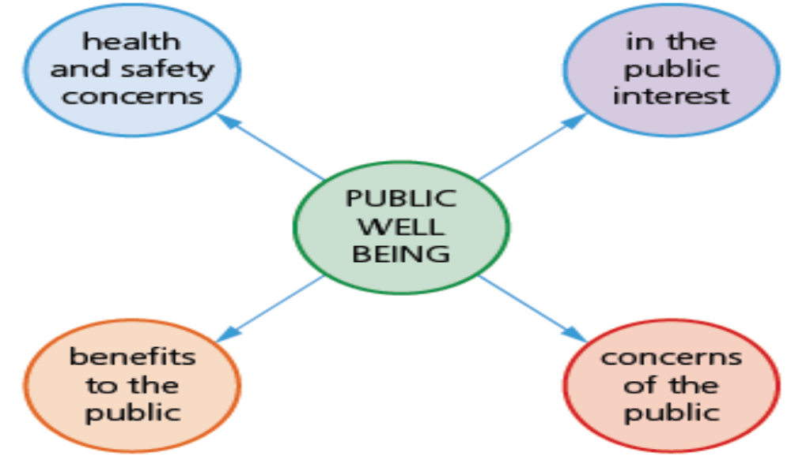
Ethics and Ownership
Impact of Software / Hardware developed for the Public
In general, any software that is being devevloped for the public has to to be as fas as possible, meet the above conditions.

Slide 9
Ethics and Ownership
Impact of Software / Hardware developed for the Public
Example 1: Los Angeles (LA) airport shutdown in 2007
In this example, aeroplanes at LA airport (in the USA) were grounded due to a simple software issue: a faulty network card in a device continued to send incorrect data over the airport’s network. Eventually, the whole of the USA Customs and Borders Agency came to an abrupt standstill at LA airport. This resulted in all flights leaving and landing at the airport being cancelled for about eight hours until the fault was cleared. It cost several million US dollars in lost revenue to the aeroplane operators. The impact on the general public was cancellation of holidays, loss of business and general frustration.

Slide 10
Ethics and Ownership
Impact of Software / Hardware developed for the Public
Example 2: Exploding laptop computers in 2008
Japan holds an annual trade show displaying the latest in computer technology. In 2008, during the trade show, a number of Dell laptop computers burst into flames under the full view of the visiting public and television cameras. The problem was traced back to faulty batteries in the laptops which had been overheating and eventually exploded and burst into flames. As if this was not enough, the problem escalated when Apple reported similar problems with some of its tablets, laptops and desktop computers. Some 100 million computer devices had to be recalled at an estimated cost of over 300 million US dollars to the manufacturers. The impact on the general public would have been devastating if this problem had not been discovered before the devices were generally available to buy.

Slide 11
Ethics and Ownership
Ethics Issues of Software Developed that Impacts Public
Companies selling software systems which do not meet the required standard for security (inadequate protection against hacking, spyware and other security issues)
Covering up of security issues (such as the security threat which forced cloud servers to become compromised)
Release of private data (such as the celebrity photo leaks, when a cloud server was hacked)
Social media not policing subversive activity, such as hate mail and cyber bullying.

Slide 12
Ethics and Ownership
Software copyright and privacy
Software is protected by copyright laws in much the same way as music CDs, videos and articles from magazines.
When software is purchased, there are certain rules that must be obeyed:
  It is illegal to make a software copy and sell it or give it away.
  Software cannot be used on a network or used on multiple computers without a multi-use licence.
  It is illegal to use coding from copyrighted software in your own software.
  It is illegal to rent out a software package without permission to do so.
  It is illegal to use the name of copyrighted software on other software without agreement to do so

Slide 13
Ethics and Ownership
Software Licensing
There are two main types of software licenses:
Commercial software
  Commercial software is available to customers for a fee, providing a licence for one genuine copy to be used on a single device, or a multi-use licence for multiple users (eg: Adobe Photoship)
Free Software and the Open Source Initiative
  Non-profit organisations that promote the benefits of giving users the freedom to run, copy, change and adapt software (eg:Libre Office Suite).
  Users are given the freedom to run the software, study the program source code and modify it, redistribute copies of the software and code modified by user to friends and family.

Slide 14
Ethics and Ownership
Free Software & Open Source Initiative
Principles to ensure the philosophy of the Open Source Initiative is adhered to:
  Free Redistribution - license shall not restrict any party from selling or giving away the software
  Source Code - Program must allow distribution in source code as well as compiled form
  Derived Works - license allow modifications and distributions under same terms as the original software
  No Discrimination Against Persons or Groups - license must not discriminate against any persons or groups
  No Discrimination Against Fields of Endeavor - license must not restrict anyone from making use of the program in a specific field of endeavor such as business, or from being used for genetic research.
  Distribution of License - Everyone should have the rights to redistribute the license.
  License Must Not Be Specific to a Product - rights attached to the program must not depend on the program’s being part of a particular software distribution.
  License Must Not Restrict Other Software - license must not place restrictions on other software that is distributed along with the licensed software.

Slide 15
Ethics and Ownership
Free Software & Open Source Initiative
Freeware: software a user can download from the internet free of charge.
  Once the software has been downloaded, there are no fees associated with using the software (examples include: Adobe Reader, Skype and some media players).
Shareware: software that allows users to try out some software free of charge for a trial period.
  At the end of the trial period, the author of the software will request that the user pay a fee if you wish to continue using it.
  Shareware is protected by copyright laws and users must not use the source code in any of their own software without permission.

Slide 16
Ethics and Ownership
Class Activity
Describe why it is necessary to produce a code of ethics to cover the computing and electonics industries.

